Slide 1
Dielectric Constant Experiments Summary
Yutong Zhao
Jan 25th ,2018

Slide 2
Task list
6.5.1 NaCl, NH₄NO₃, KNO₃, NaNO₃,KClO₃ varying humidity from 0-10%
6.5.2 Mixing two powders of varying humidity from 0-10%
6.5.3 Aluminum powder
6.5.4 Water
6.5.5 Icing sugar (powder) humidity from 0-10%
6.5.6 Fuel oil (car gasoline and diesel)

Slide 3
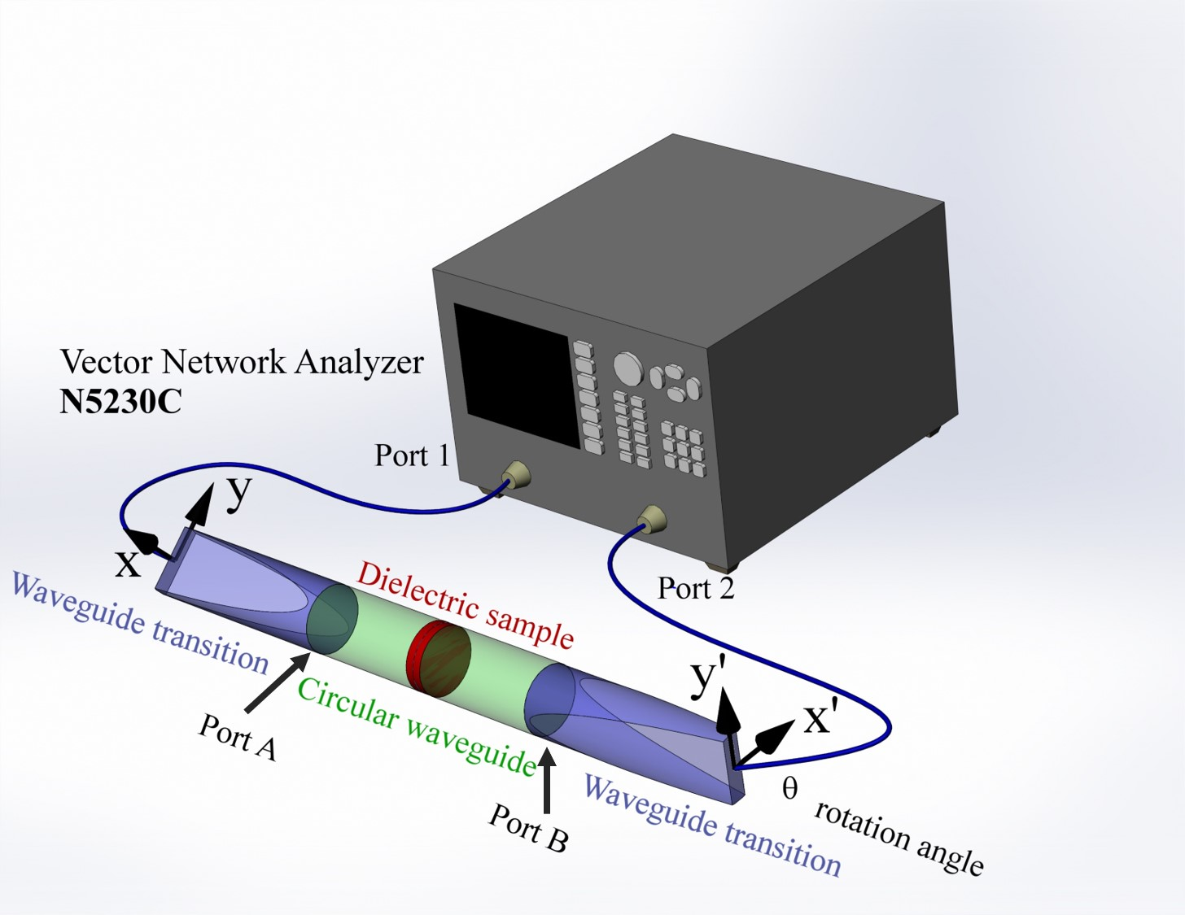
Experiment setup
Notes:
1 VNA connect the 1D cavity
2.Rotating angle was set as 45

Slide 4
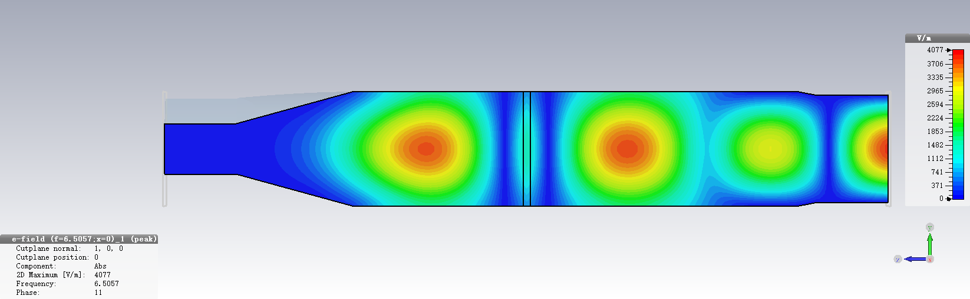
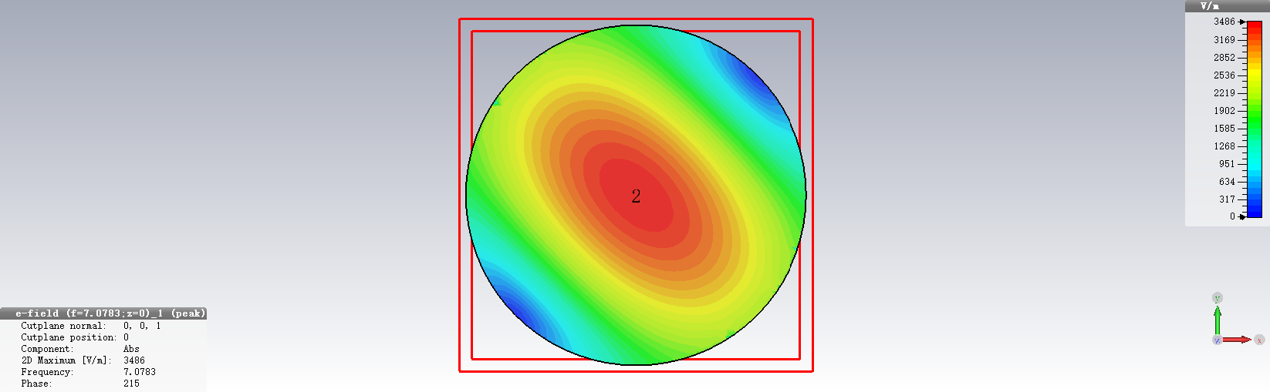
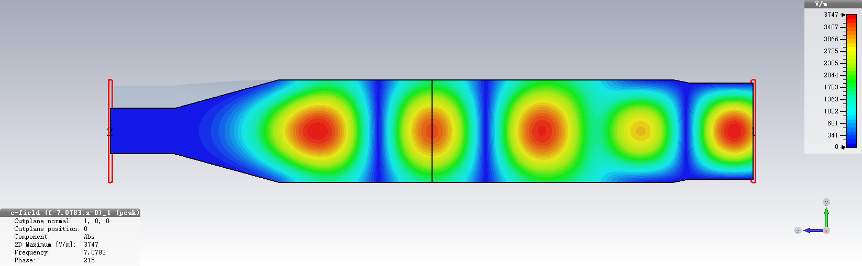
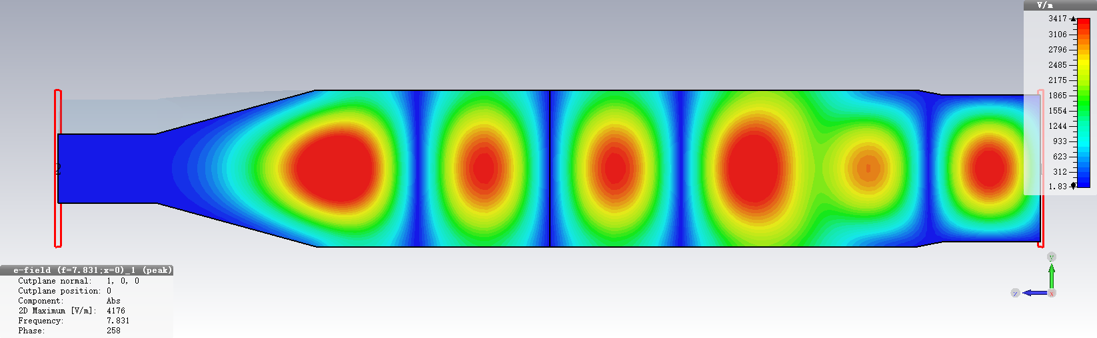
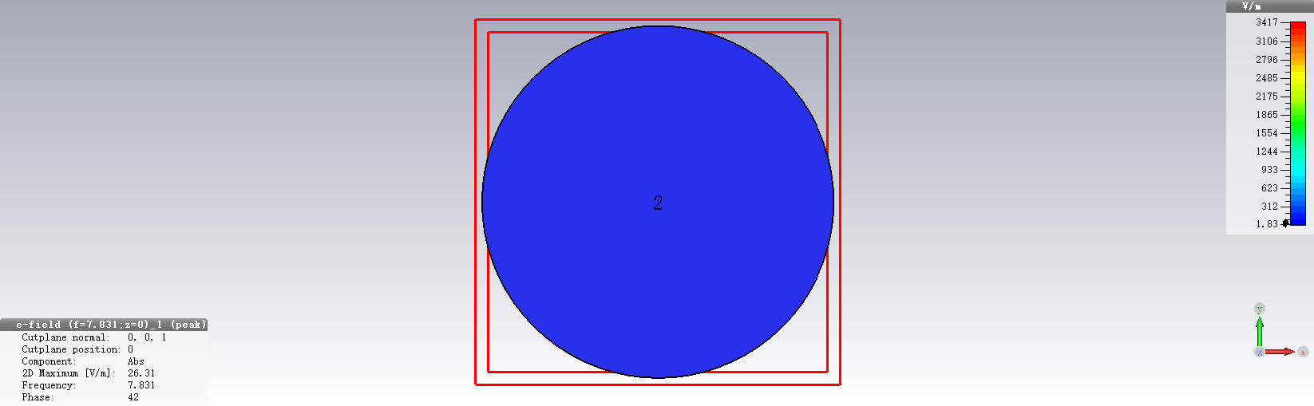
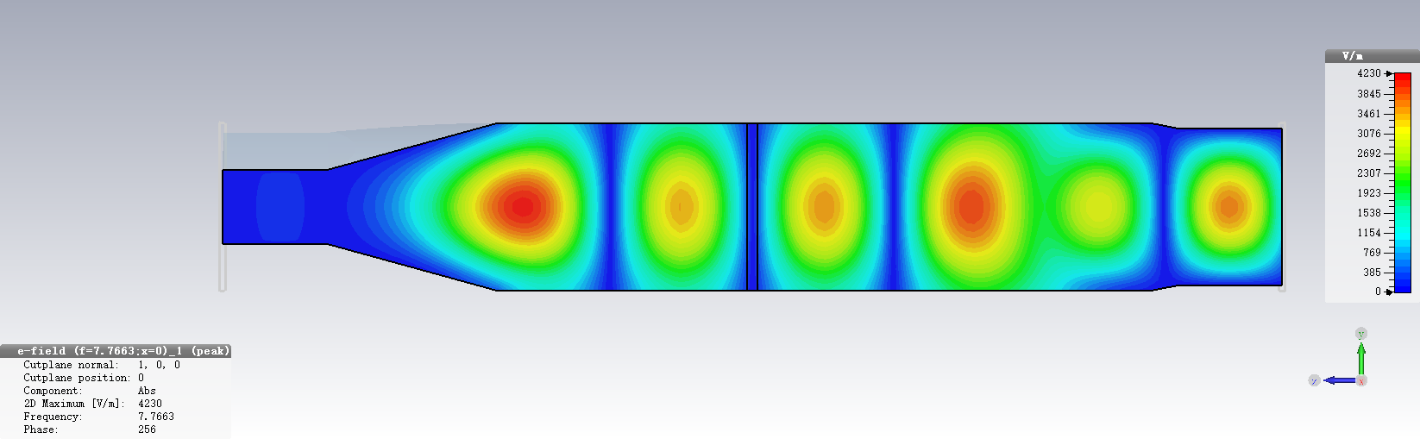
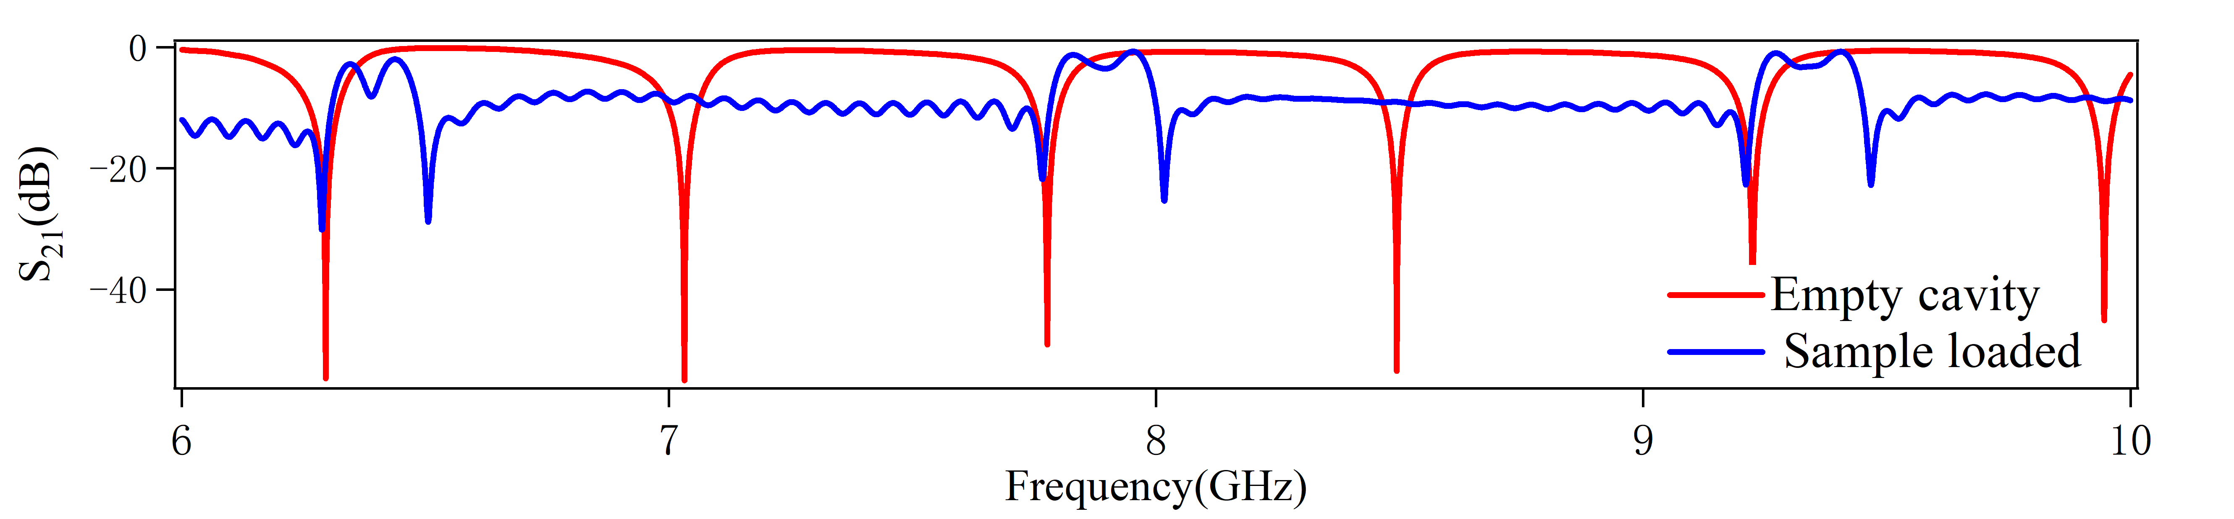
Simulations (E field, θ = 45º)
E-mode
_{Z = 0 plane}
H-mode
S₂₁
Notes:
The simulation only show the result of E field at 45o.
For E-mode, the E-field reaches the maximum at center, and for H-mode, it reaches the minimum at center.

Slide 5
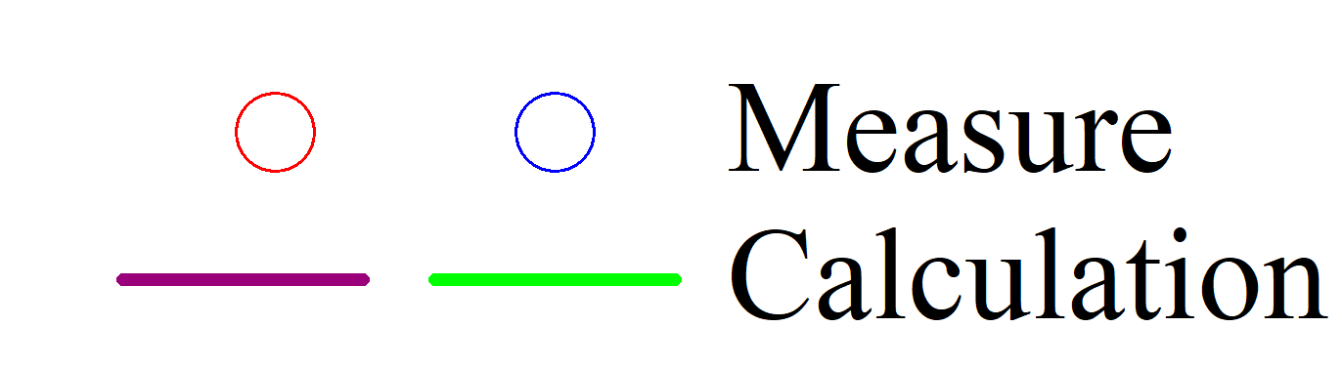
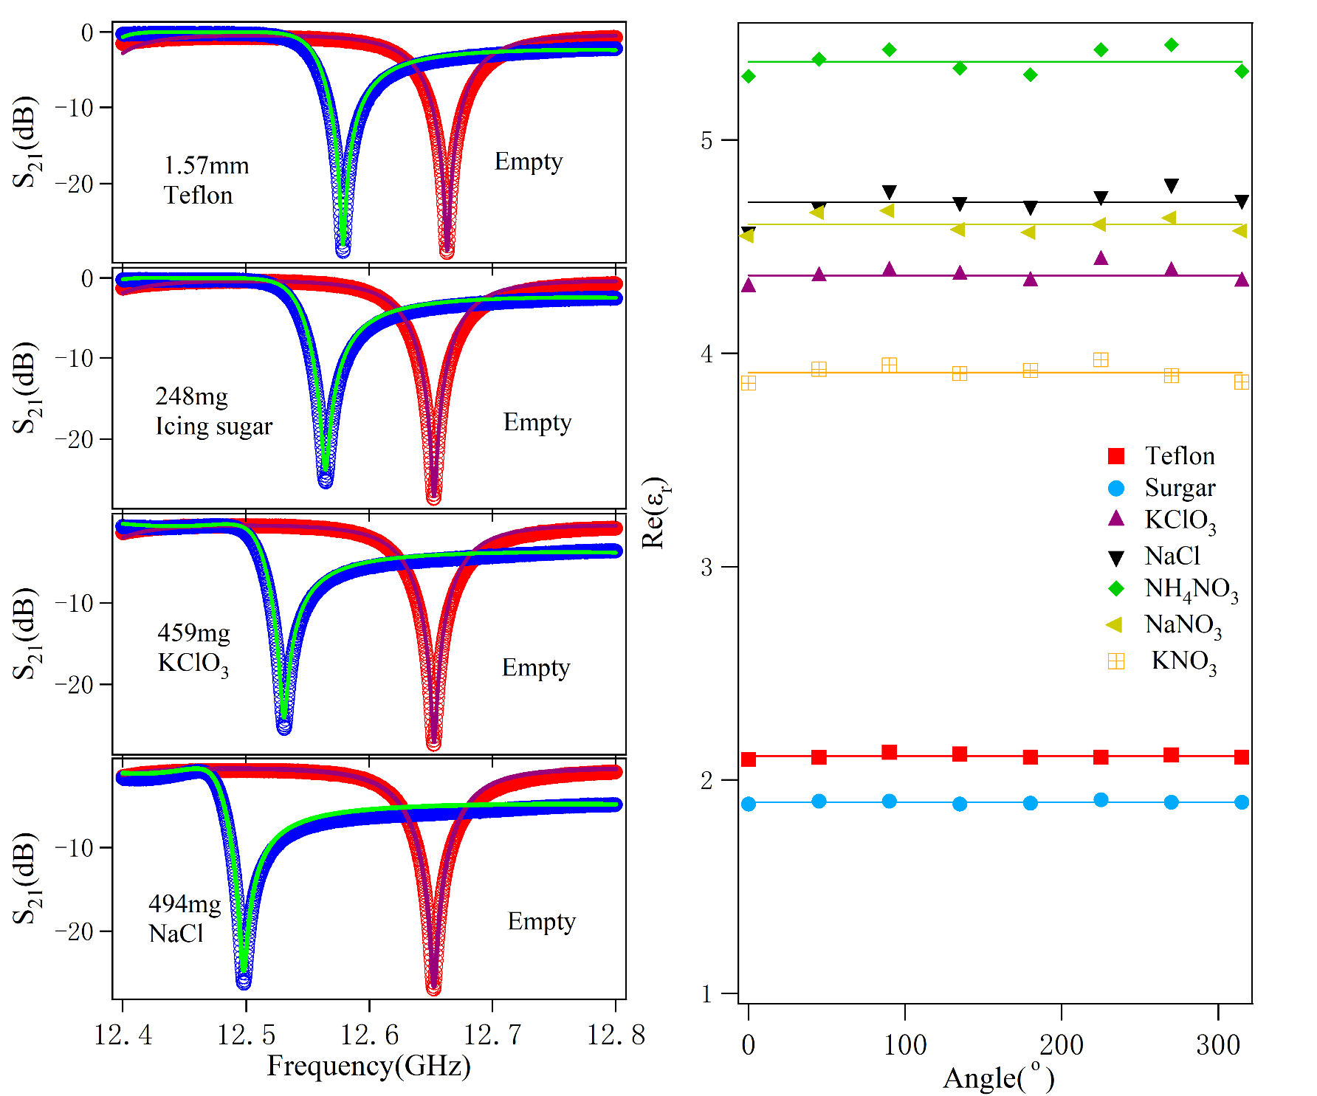
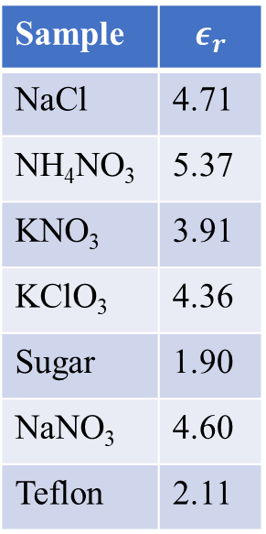
Resonant method
Error bar
1.09%
1.43%
0.97%
0.89%
0.96%
0.51%
0.38%
1.57mm
Teflon
Sample | $$ε_{r}$$
NaCl | 4.71
NH₄NO₃ | 5.37
KNO₃ | 3.91
KClO₃ | 4.36
Sugar | 1.90
NaNO₃ | 4.60
Teflon | 2.11
248mg
icing sugar
459mg
KClO₃
494mg
NaCl

Slide 6
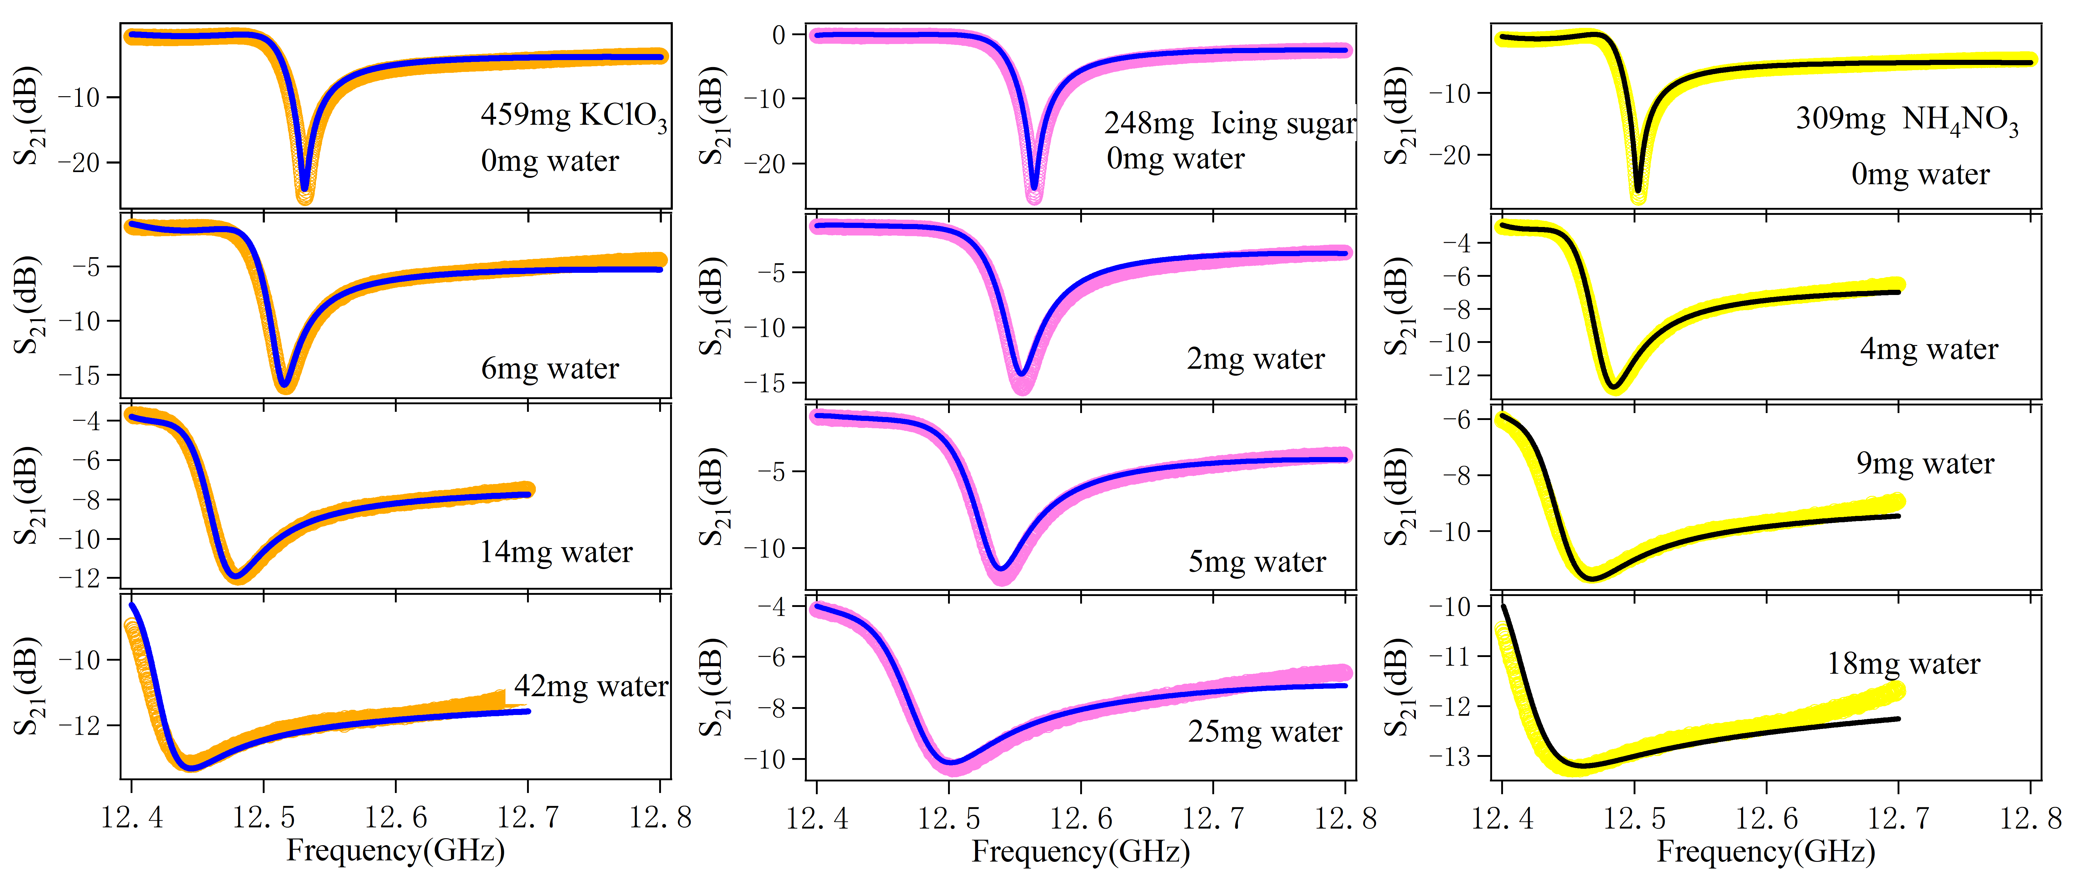
Spectra vs. humidity
459mg KClO₃
248mg icing sugar
309mg NH₄NO₃

Slide 7
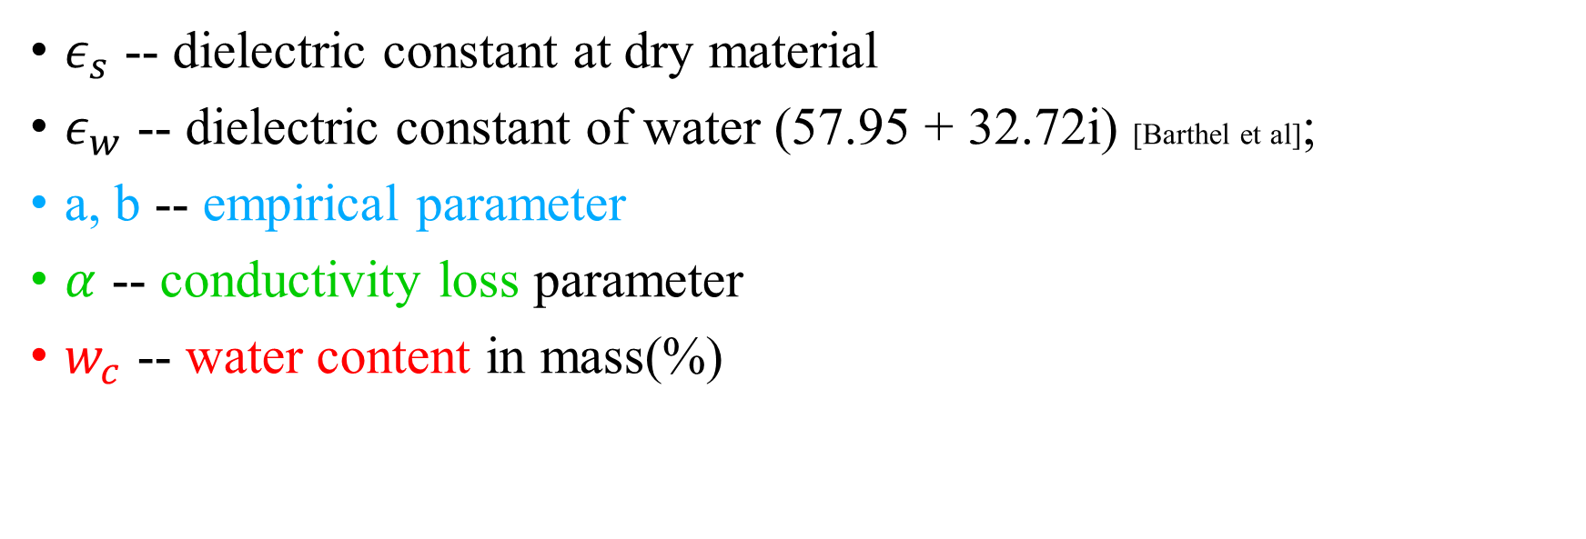
Empirical model for water content
$$ε=ε_{s}+aε_{w}w_{c}+bε_{w}w_{c}^{2}+i⋅αw_{c}^{2}$$
$ε_{s}$ -- dielectric constant at dry material
$ε_{w}$ -- dielectric constant of water (57.95 + 32.72i) [Barthel et al];
a, b -- empirical parameter
$α$ -- conductivity loss parameter
$w_{c}$ -- water content in mass(%)

Slide 8
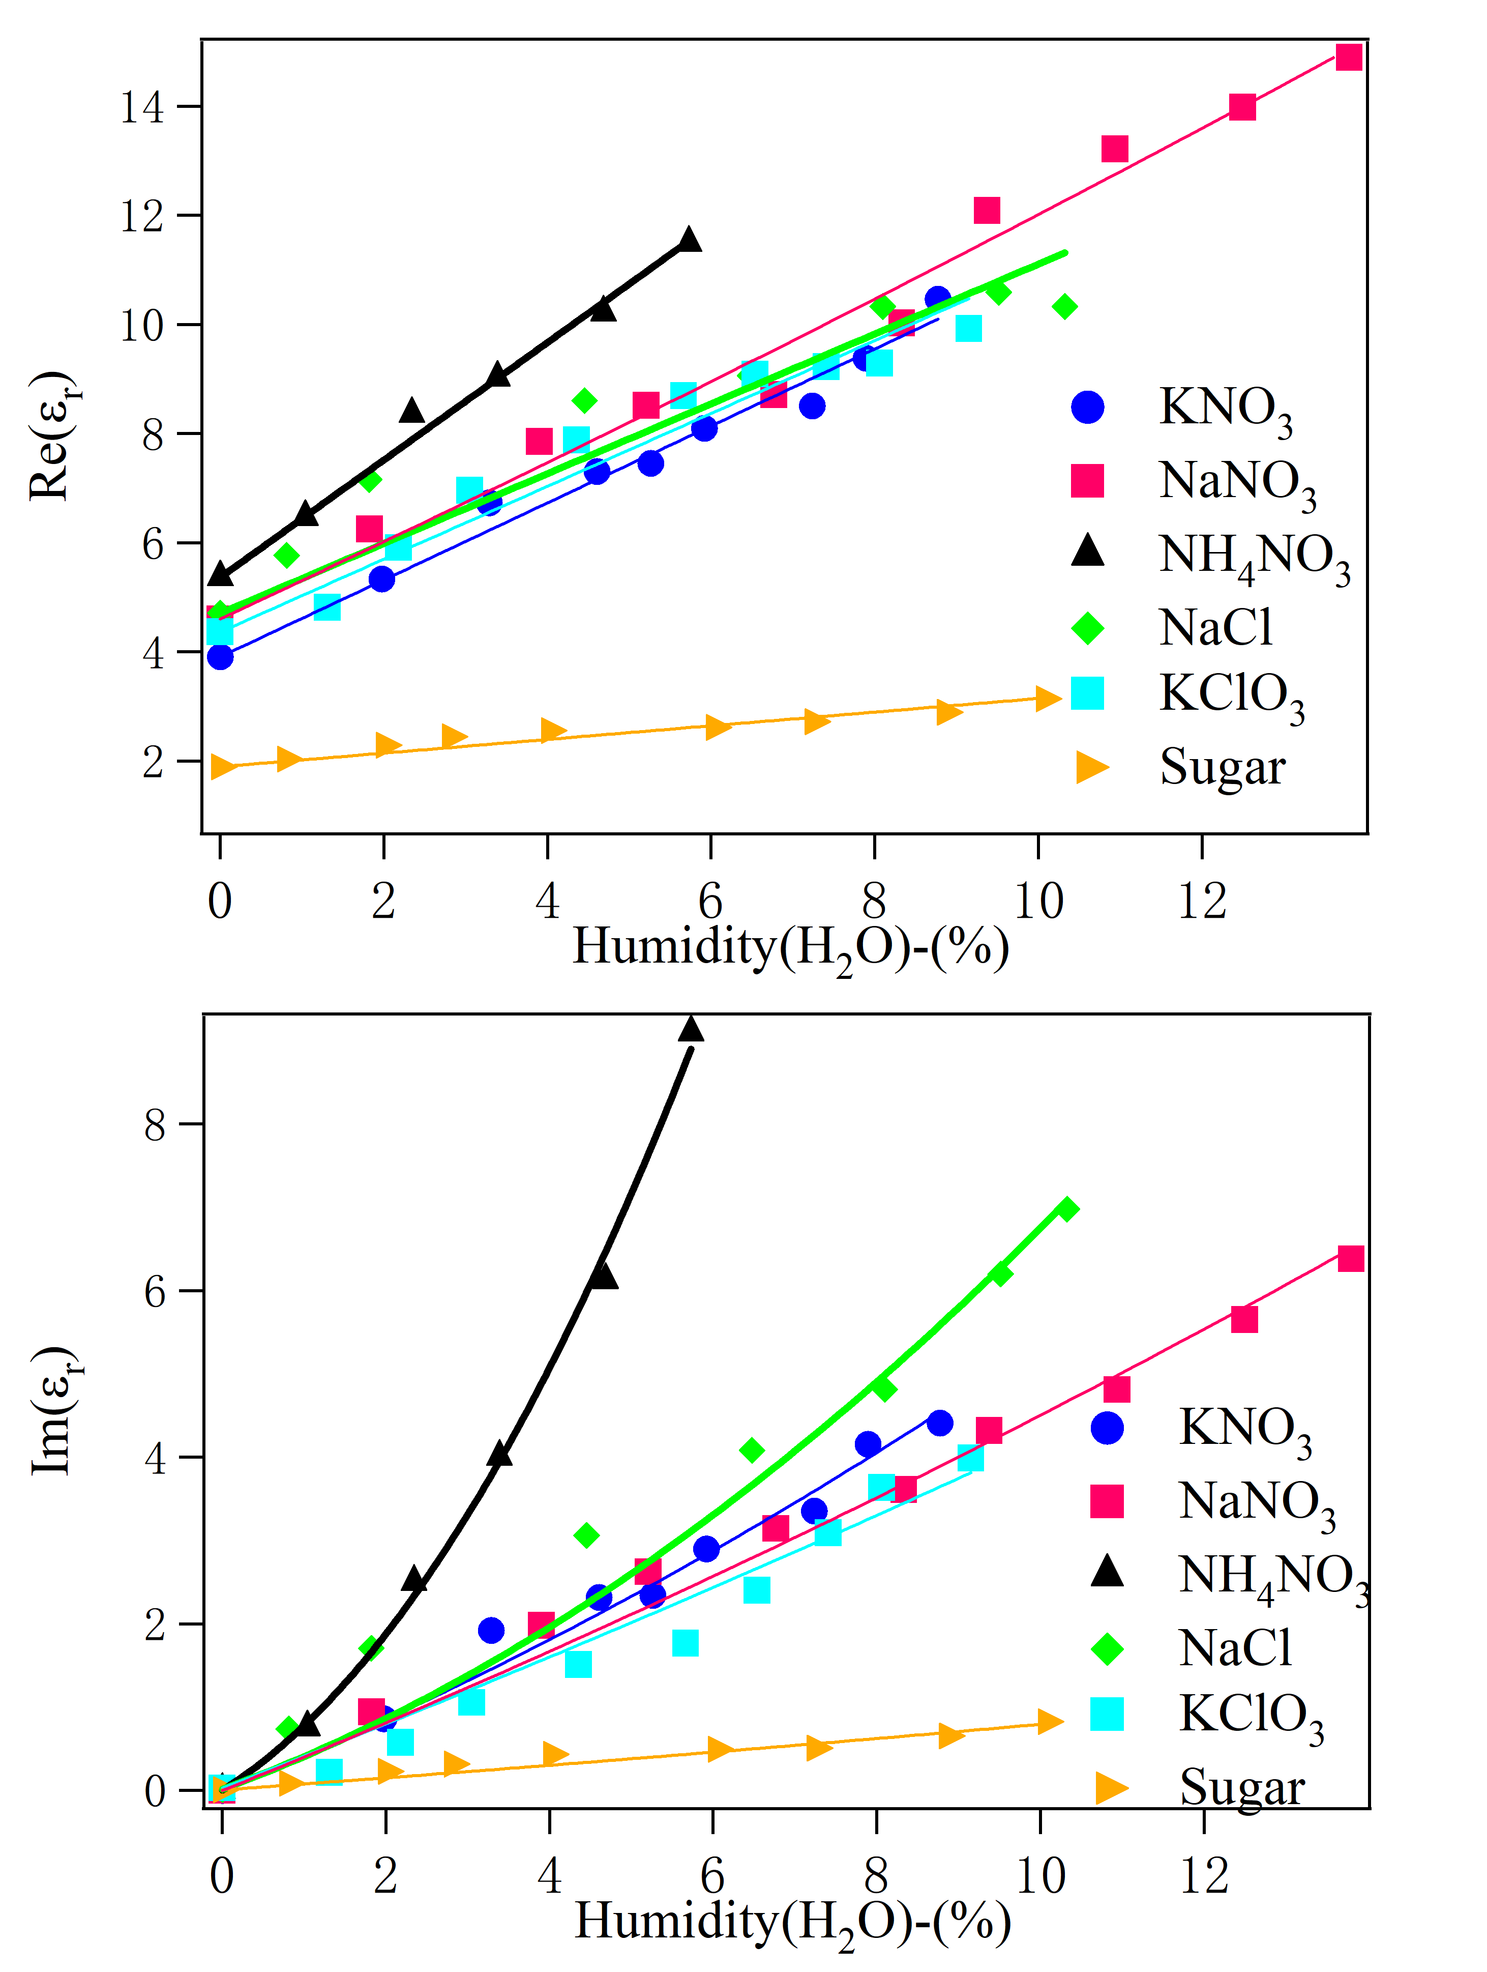
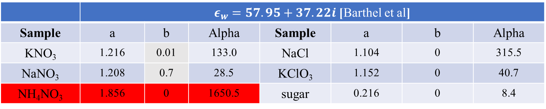
Pure chemicals at humidity from 0-10%
Solid lines: calculation results
Real part
Imaginary
part
 | $ε_{w}=57.95+37.22i$ [Barthel et al]
Sample | a | b | Alpha | Sample | a | b | Alpha
KNO₃ | 1.216 | 0.01 | 133.0 | NaCl | 1.104 | 0 | 315.5
NaNO₃ | 1.208 | 0.7 | 28.5 | KClO₃ | 1.152 | 0 | 40.7
NH₄NO₃ | 1.856 | 0 | 1650.5 | sugar | 0.216 | 0 | 8.4

Slide 9
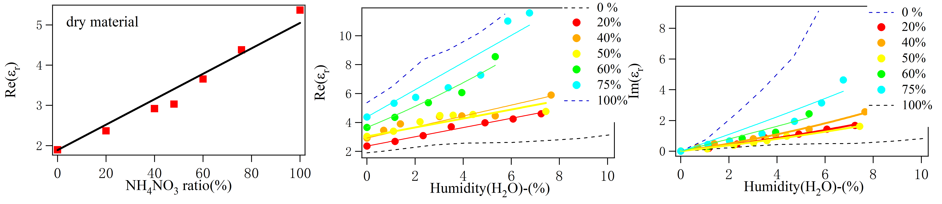
Mixture: NH₄NO₃ in sugar
Percent(%) | a | b | Alpha
0 | 0.216 | 0 | 8.4
20 | 0.522 | 0 | 80.5
40 | 0.656 | 0 | 109.5
50 | 0.536 | 0 | 57.5
60 | 1.176 | 0.4 | 84.5
75.87 | 1.624 | 0.4 | 144
100 | 1.856 | 0 | 1650.5
Real part
Imaginary part

Slide 10

Task list
6.5.1 NaCl, NH₄NO₃, KNO₃, NaNO₃,KClO₃ varying humidity from 0-10%
6.5.2 Mixing two powders of varying humidity from 0-10%
6.5.3 Aluminum powder
6.5.4 Water
6.5.5 Icing sugar (powder) humidity from 0-10%
6.5.6 Fuel oil (car gasoline and diesel)

Slide 11

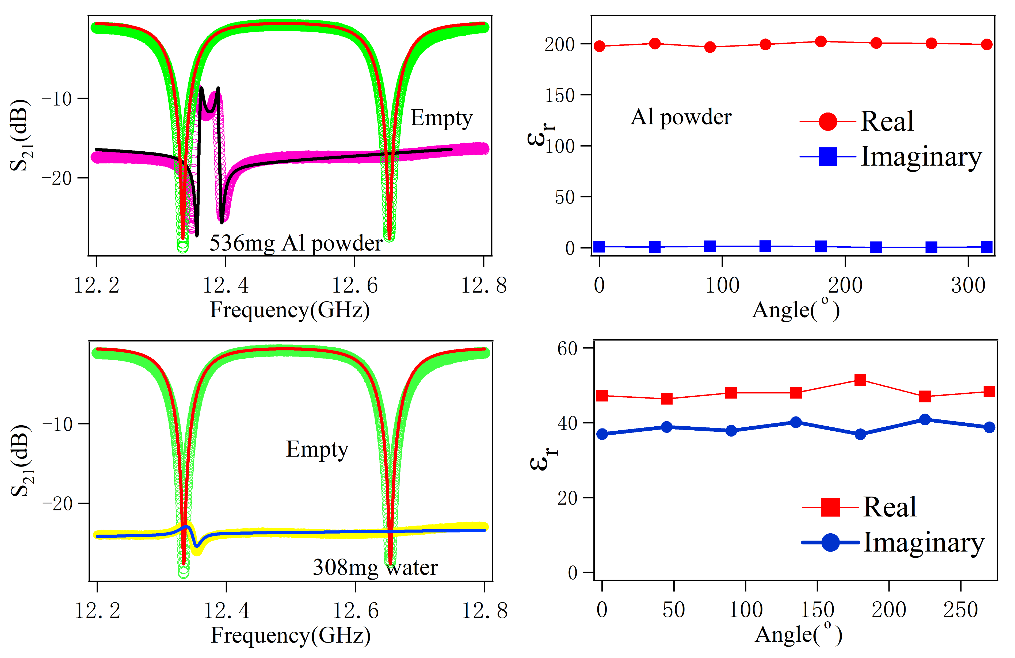
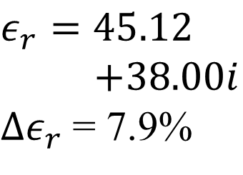
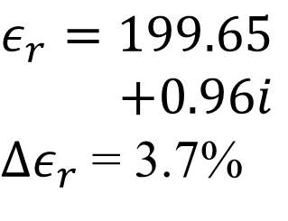
Problem: water and Al powder
$$ε_{r}=199.65$$
$+0.96i$
$Δε_{r}$= 3.7%
$$ε_{r}=45.12$$
$+38.00i$
$Δε_{r}$= 7.9%
water

Slide 12
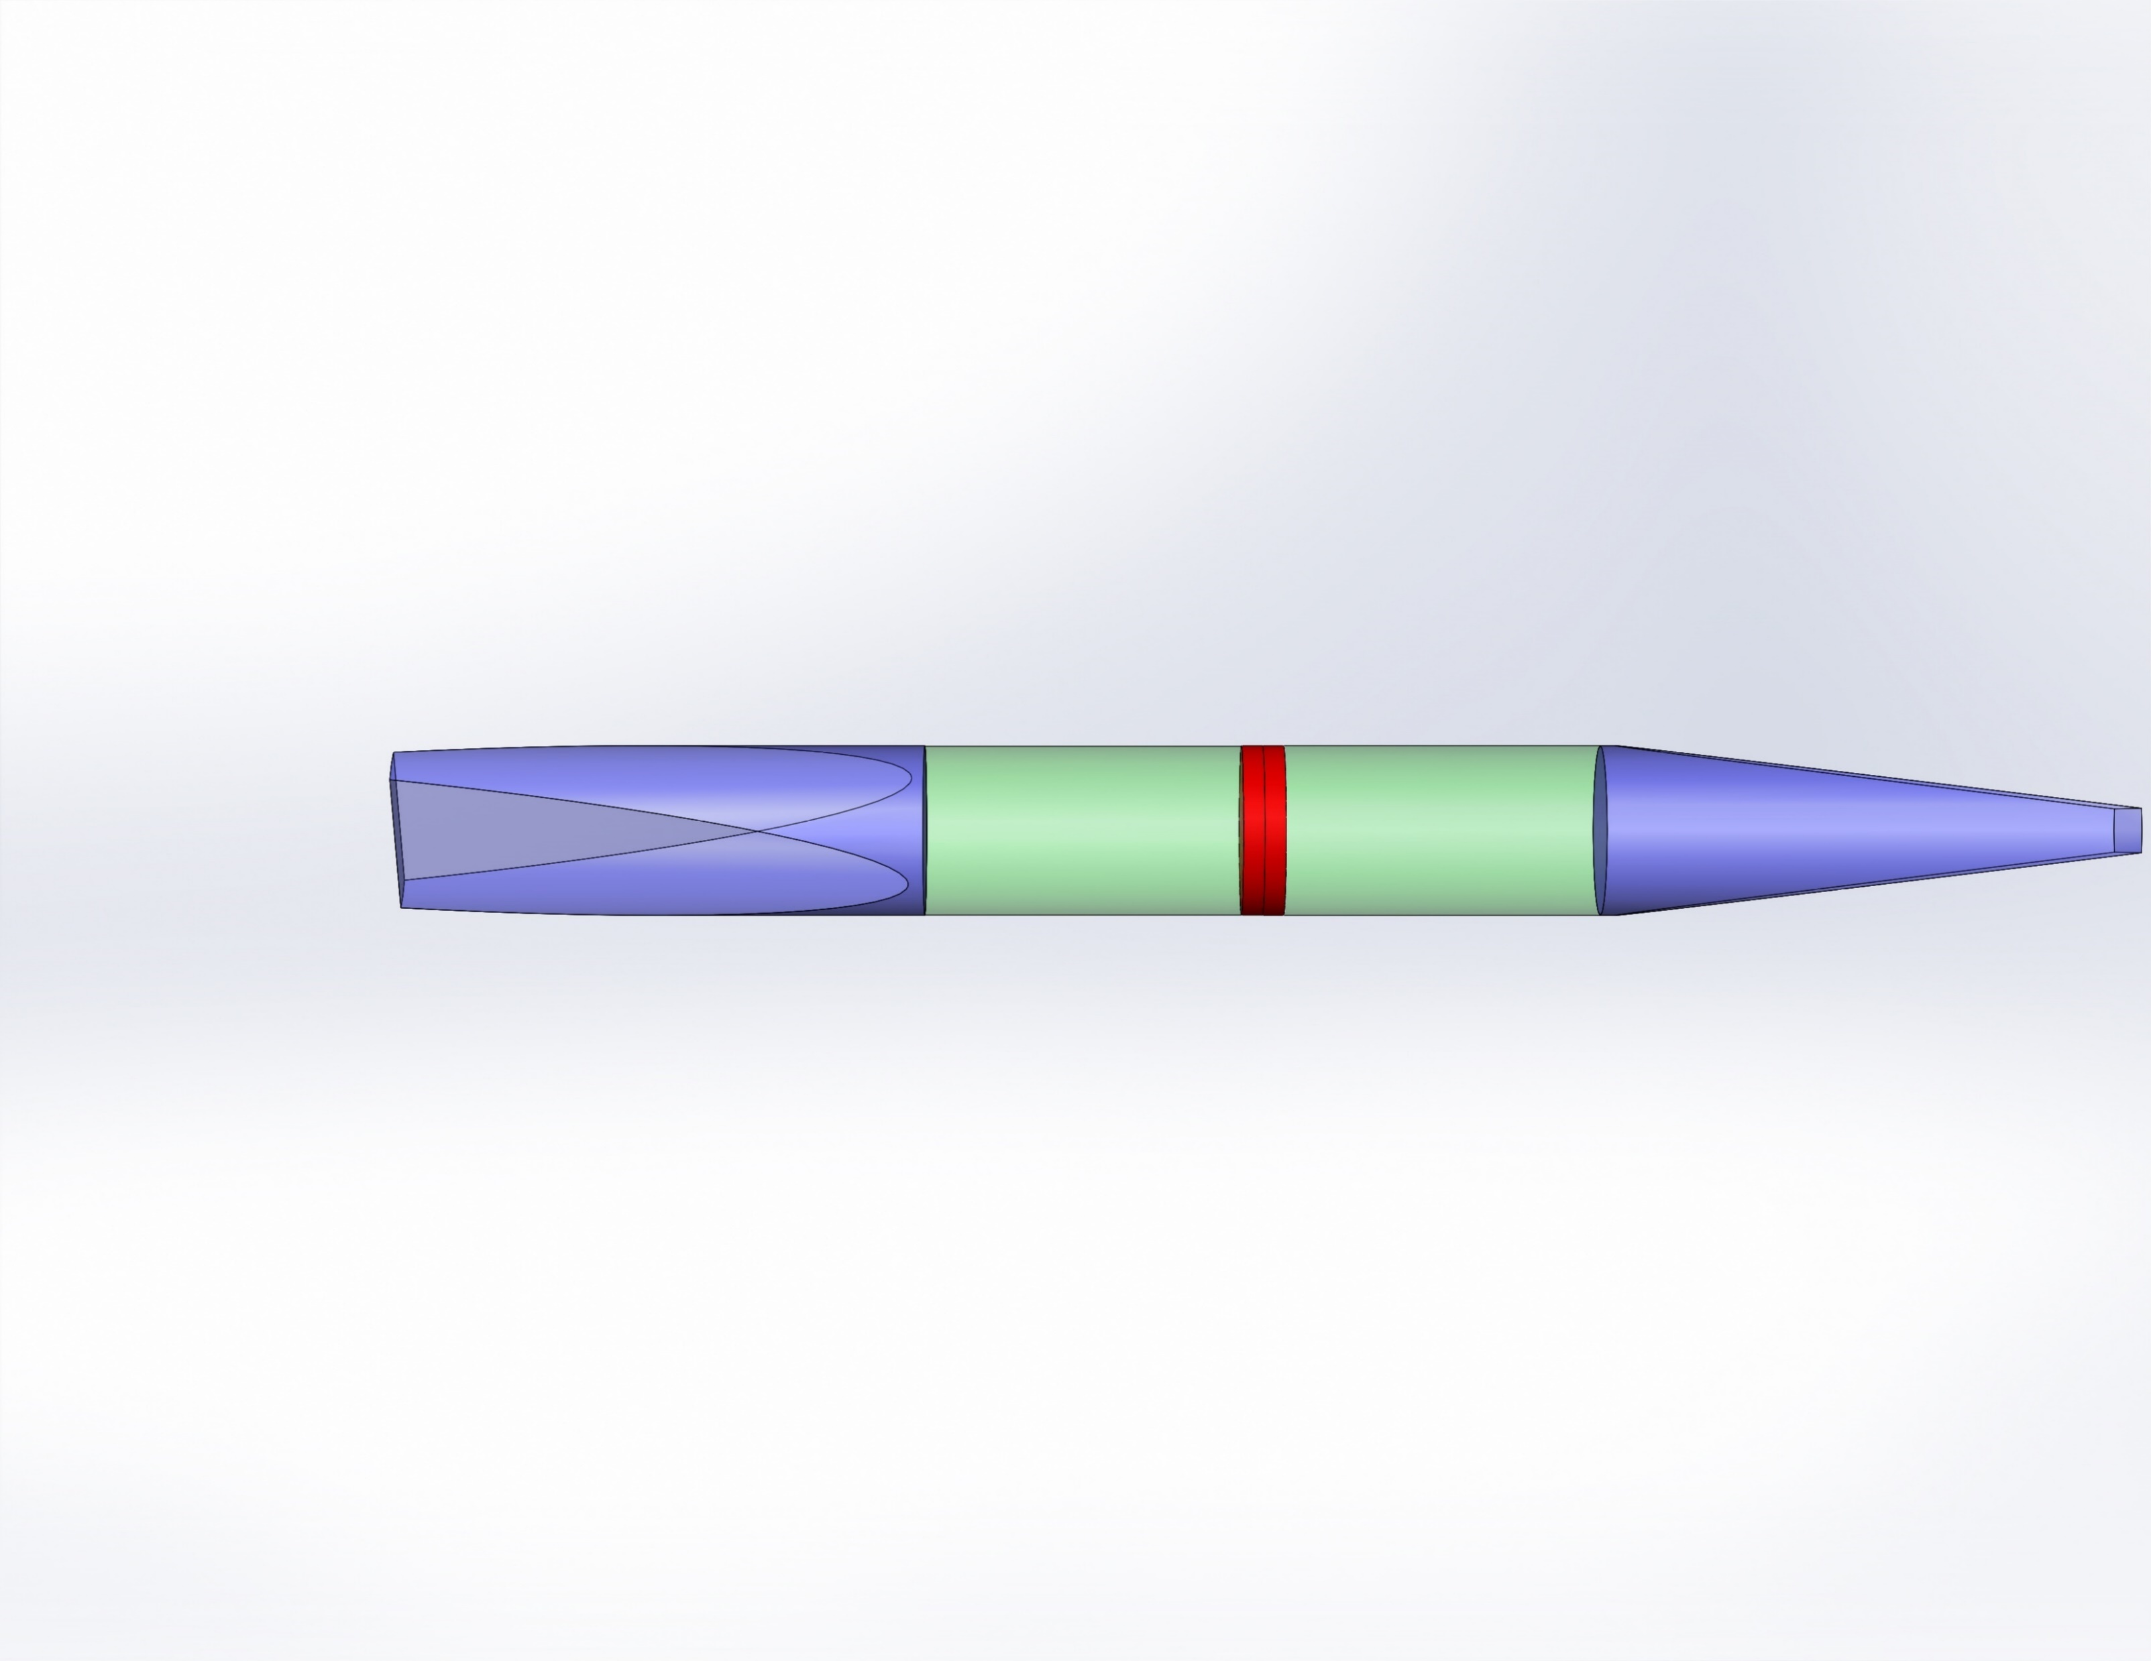
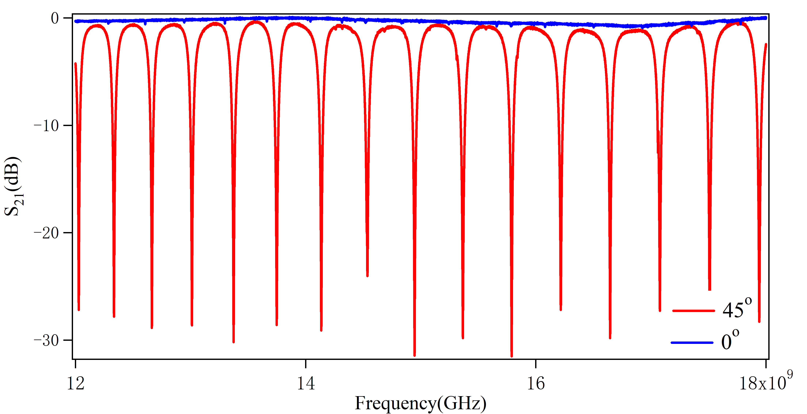
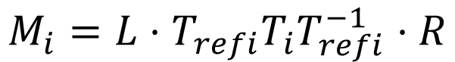
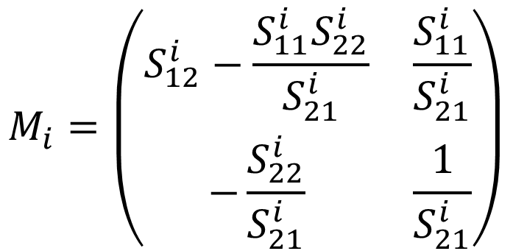
Non-resonant measurement (theta = 0º)
Surface 1
Surface 2
Air
Air
Port 1
Port 2
L
R
Sample
$$M_{i}=L⋅T_{refi}T_{i}T_{refi}^{−1}⋅R$$
$$M_{i}=\left(\begin{matrix}S_{12}^{i}−\frac{S_{11}^{i}S_{22}^{i}}{S_{21}^{i}} & \frac{S_{11}^{i}}{S_{21}^{i}} \\ −\frac{S_{22}^{i}}{S_{21}^{i}} & \frac{1}{S_{21}^{i}}\end{matrix}\right)$$
➔ Measure 4 S parameters
Define transfer matrix
Fit result

Slide 13
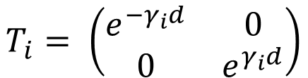
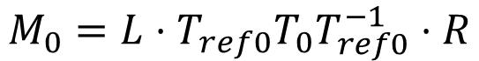
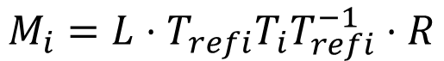
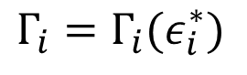
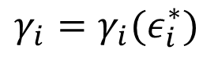
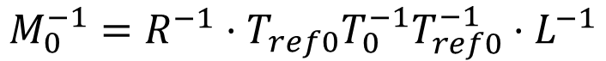
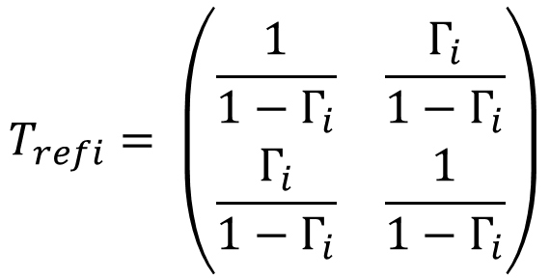
Definition of transfer matrix
Surface 1
Surface 2
$$T_{i}= \left(\begin{matrix}e^{−γ_{i}d} & 0 \\ 0 & e^{γ_{i}d}\end{matrix}\right)$$
Tran
$$γ_{i}=γ_{i}(ε_{i}^{∗})$$
Air
Air
$$T_{refi}= \left(\begin{matrix}\frac{1}{1−Γ_{i}} & \frac{Γ_{i}}{1−Γ_{i}} \\ \frac{Γ_{i}}{1−Γ_{i}} & \frac{1}{1−Γ_{i}}\end{matrix}\right)$$
surface
L
R
I
$$Γ_{i}=Γ_{i}(ε_{i}^{∗})$$
Tran
Sample
Refl
$$M_{i}=L⋅T_{refi}T_{i}T_{refi}^{−1}⋅R$$
Sample measure
$$M_{0}=L⋅T_{ref0}T_{0}T_{ref0}^{−1}⋅R$$
Standard measure
$$M_{0}^{−1}=R^{−1}⋅T_{ref0}T_{0}^{−1}T_{ref0}^{−1}⋅L^{−1}$$
$${{Tr(M}_{i}M}_{0}^{−1})=Tr{(T}_{refi}T_{i}T_{refi}^{−1}⋅T_{ref0}T_{0}^{−1}T_{ref0}^{−1})$$
$${M_{i}M}_{0}^{−1}=L⋅T_{refi}T_{i}T_{refi}^{−1}⋅RR^{−1}⋅T_{ref0}T_{0}^{−1}T_{ref0}^{−1}⋅L^{−1}$$
$${M_{i}M}_{0}^{−1}=L{(T}_{refi}T_{i}T_{refi}^{−1}⋅T_{ref0}T_{0}^{−1}T_{ref0}^{−1})L^{−1}$$

Slide 14
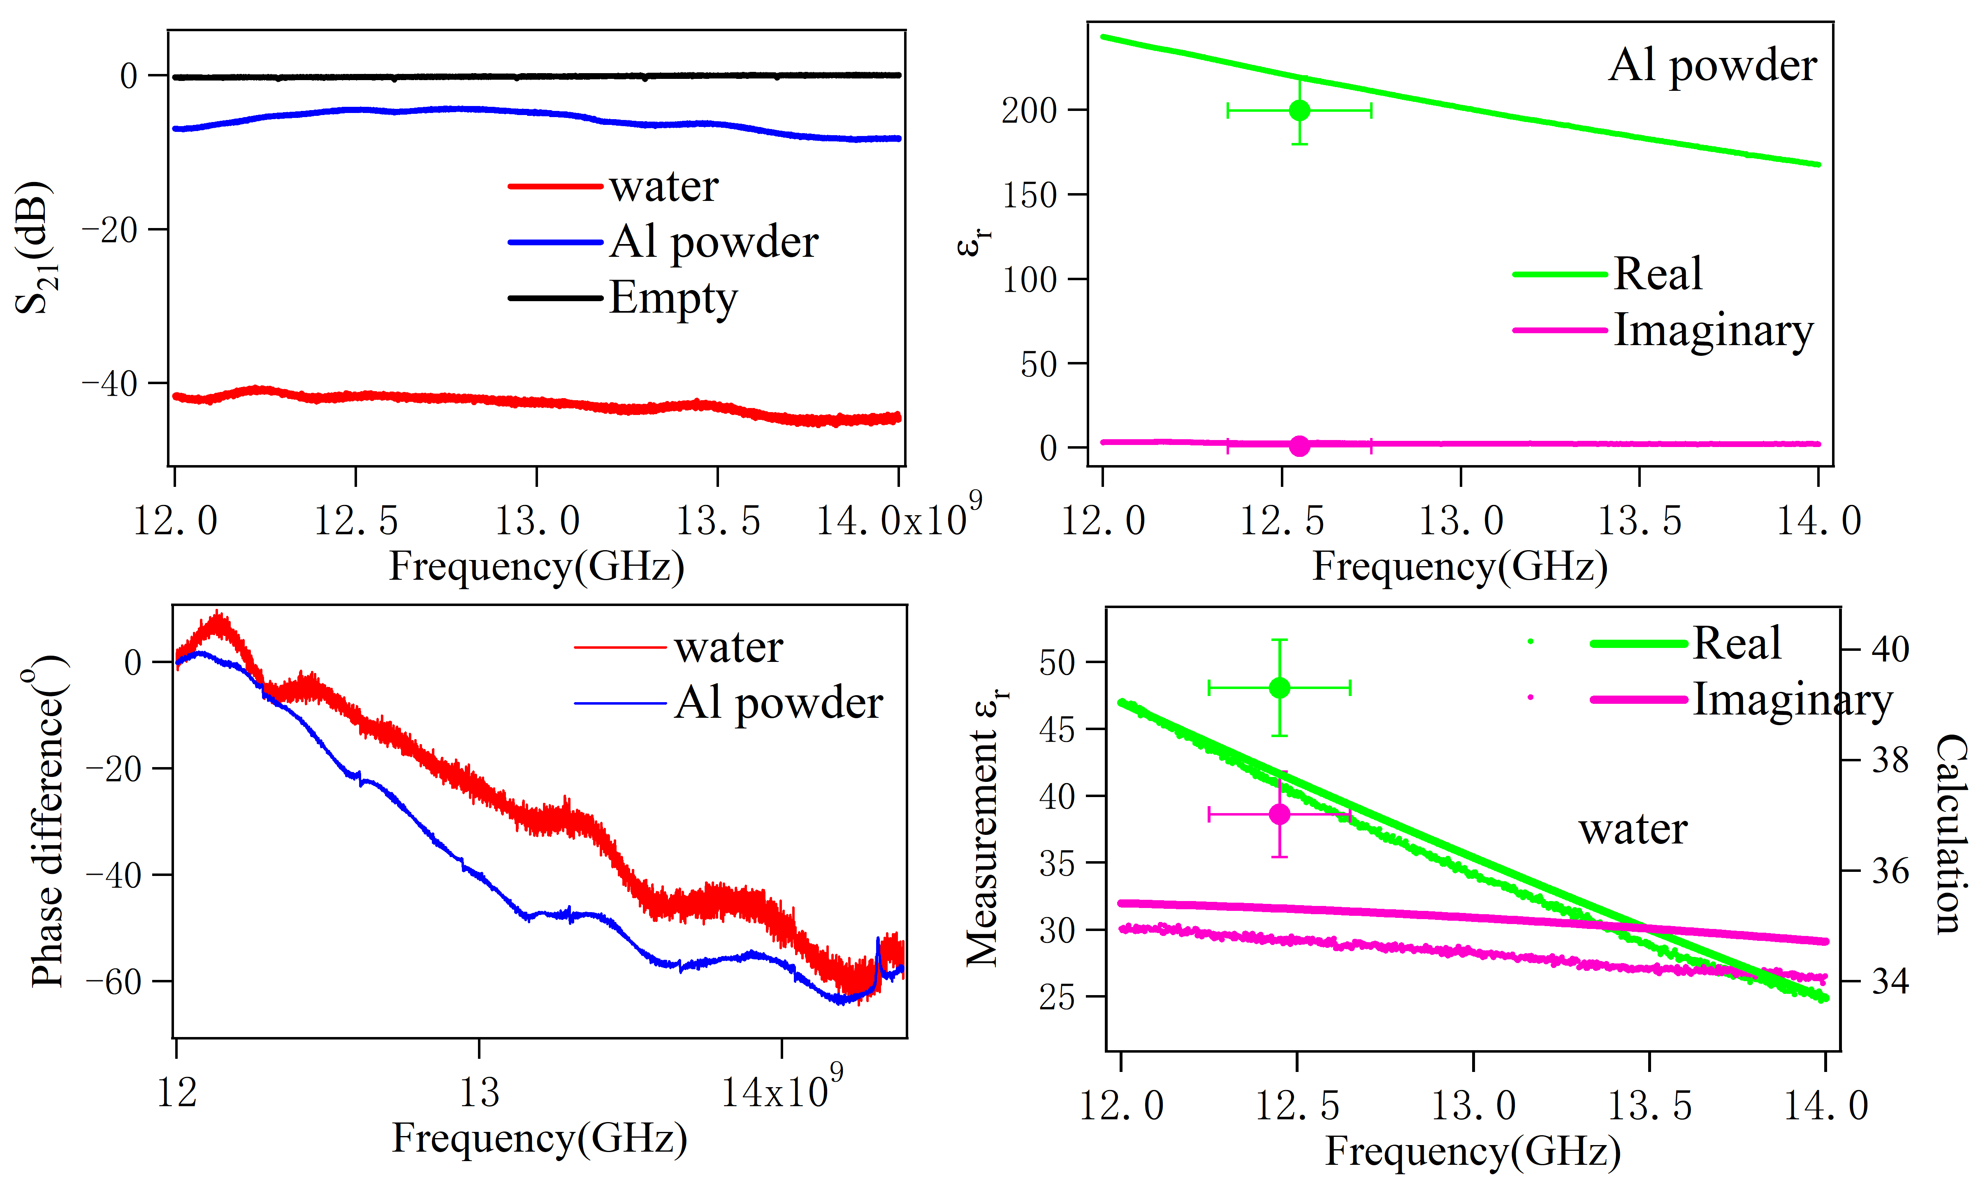
Raw data and fitting results

Slide 15
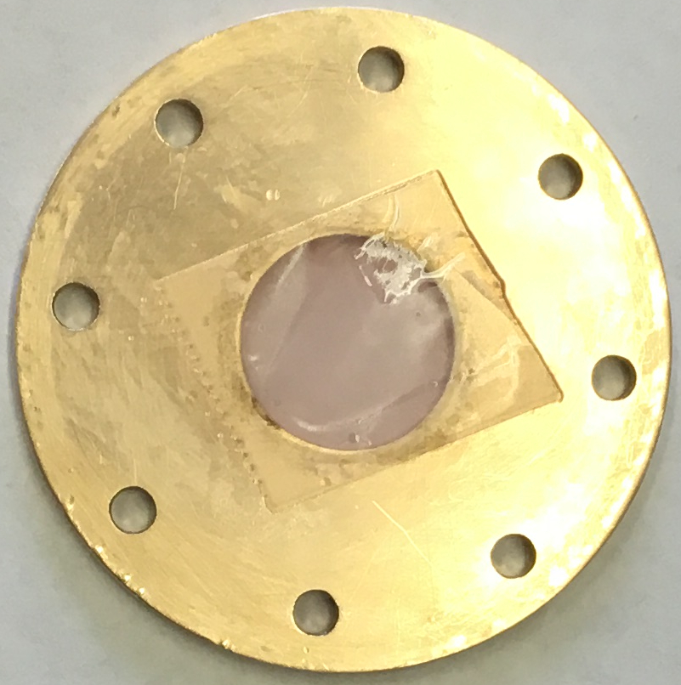
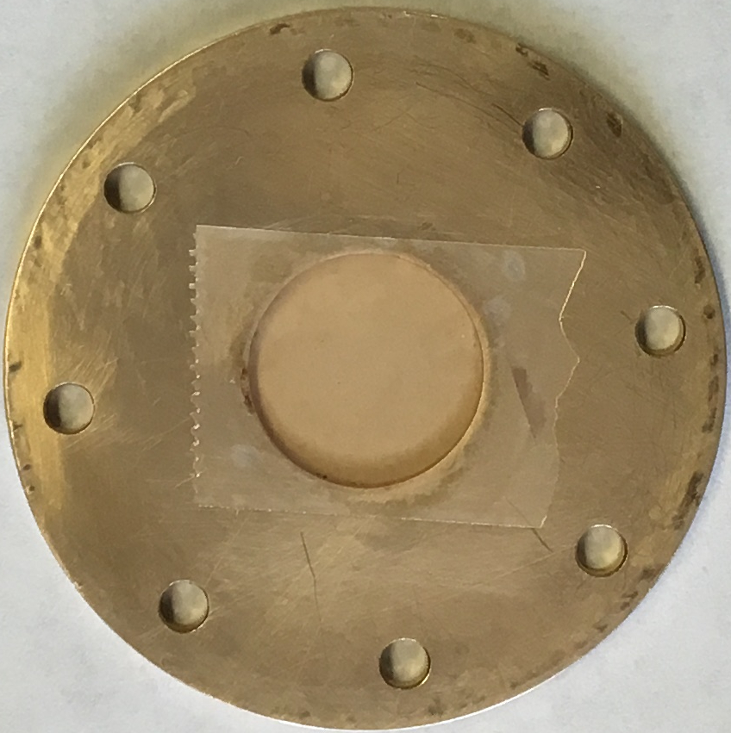
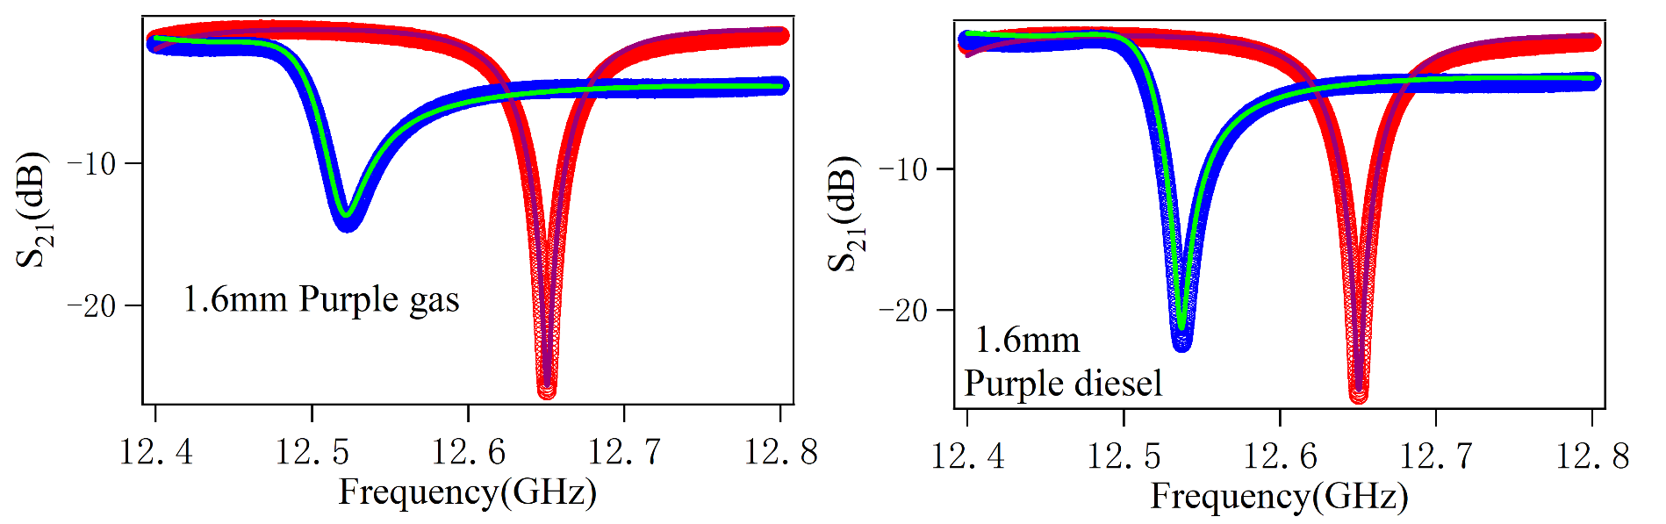
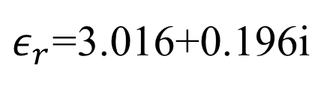
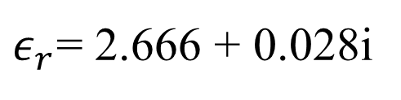
Car fuel Measurement
$ε_{r}$=3.016+0.196i
$ε_{r}$= 2.666 + 0.028i

Slide 16

Task list
6.5.1 NaCl, NH₄NO₃, KNO₃, NaNO₃,KClO₃ varying humidity from 0-10%
6.5.2 Mixing two powders of varying humidity from 0-10%
6.5.3 Aluminum powder
6.5.4 Water
6.5.5 Icing sugar (powder) humidity from 0-10%
6.5.6 Fuel oil (car gasoline and diesel)

Slide 17
Next step
Redo measurement of water.

Slide 18
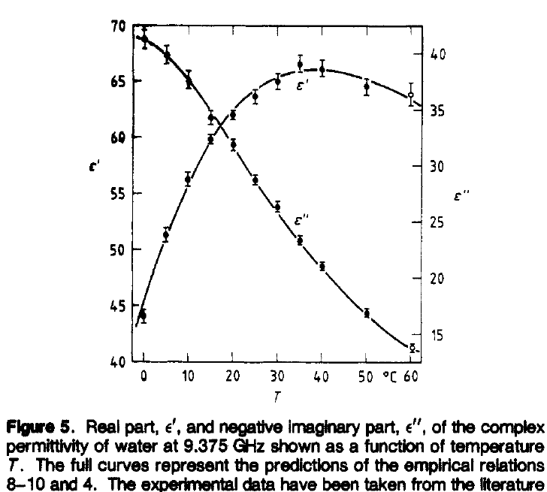
35-40
50-60

